Slide 1
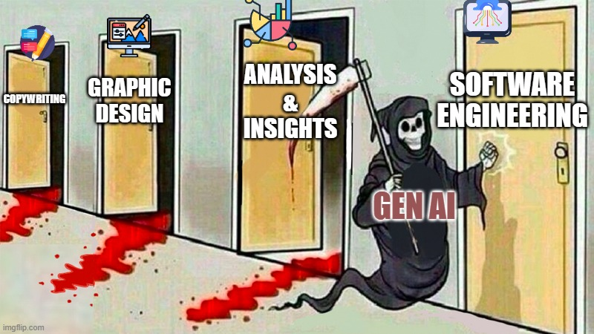


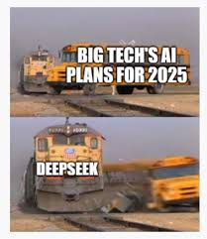
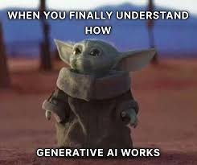
GenAI

Slide 2

AGENDA
Introduction to Generative AI
Traditional AI vs Generative AI
History of Generative AI
Applications of Generative AI
Architecture of llm TExt generation
RAG(Retrival Augmented Generation)
Architecture Of RAG
Application Of RAG
Technology stack used for build RAG
Prompt Engineering
Types of Prompt
Prompt engineering use cases
Fine Tunning
Fine Tunning vs RAG
Agentic AI

Slide 3
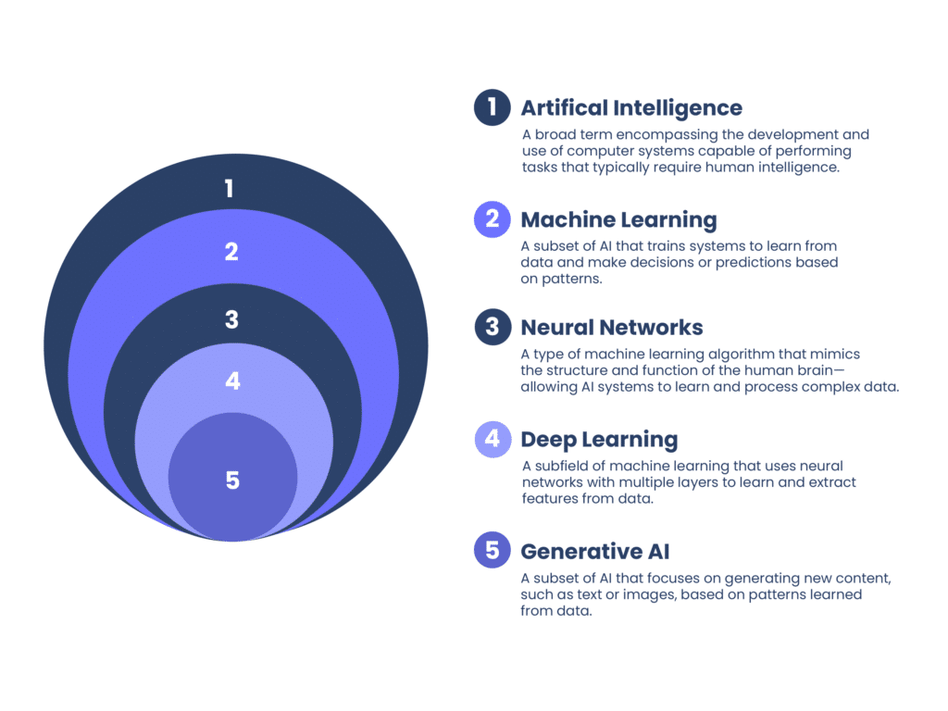
INTRODUCTION TO GENERATIVE AI
Generative AI is a branch of AI that focuses specifically on generating new content, such as images, text, or music. Unlike traditional AI systems, which are programmed with specific rules and algorithms, generative AI systems are trained on large datasets. They learn to form new content by identifying patterns and creating new variations based on those patterns. This allows generative AI systems to create original, creative content.

Slide 4
TRADITIONAL AI VS GENERATIVE AI
While both systems fall under the AI umbrella, there are some key differences between them.
The main difference lies in their functionality. Traditional AI systems are designed to perform specific tasks or solve problems. They follow pre-defined rules and algorithms to accomplish these tasks. For example, a traditional AI system can be trained to recognize and classify images of trees and flowers based on certain features.
On the other hand, generative AI systems are not limited to specific tasks. They are trained on vast amounts of data and can generate new content based on the patterns they learn from that data. For example, a generative AI system can be trained on tree and flower images and generate new images resembling trees and flowers, even if they have never seen those specific images before.

Slide 5
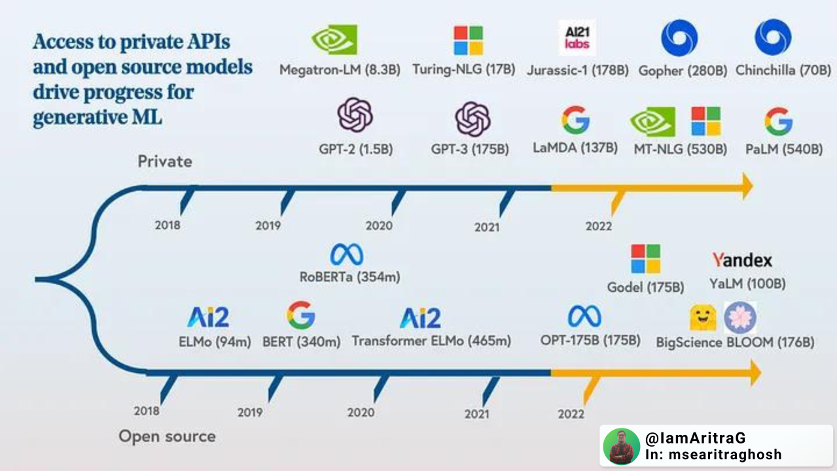
HISTORY OF GENERATIVE AI

Slide 6
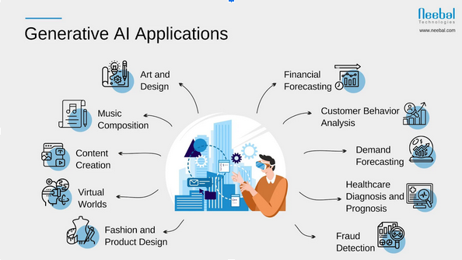
APPLICATIONS OF GENERATIVE AI

Slide 7
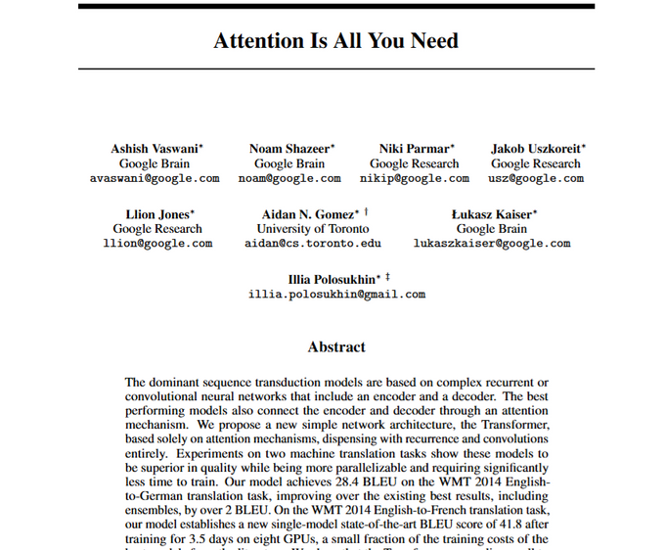
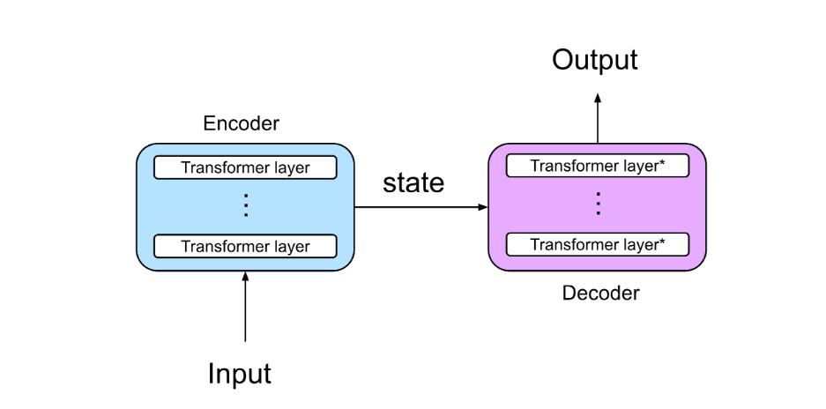
ARCHITECTURE OF LLM TEXT GENE
The transformer architecture is a neural network architecture that is used for natural language processing (NLP) tasks. It was first introduced in the paper "Attention Is All You Need" by Vaswani et al. (2017).
The transformer architecture is based on the attention mechanism, which allows the model to learn long-range dependencies between words in a sentence. This makes it well-suited for tasks such as machine translation, text summarization, and question answering. The transformer architecture consists of two main parts: an encoder and a decoder. The encoder takes a sequence of input tokens and produces a sequence of hidden states. The decoder then takes these hidden states and produces a sequence of output tokens. The encoder and decoder are both made up of a stack of self-attention layers. Self-attention is a mechanism that allows each token in a sequence to attend to all other tokens in the sequence. This allows the model to learn the relationships between different tokens in the sequence.

Slide 8
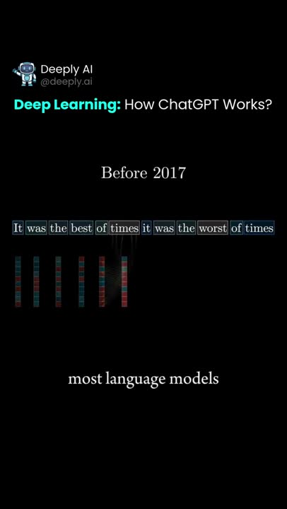
How transformer work

Slide 10


IMPLIMENT LLM IN CHATBOT
llm model:
gemini api key from that link- https://aistudio.google.com/app/apikey
Technology Stack:
Github(repository):
https://github.com/enderXM249/ChatApp

Slide 11
WHAT IS RAG?
RAG stands for Retrieval-Augmented Generation.
It's an advanced technique used in Large Language Models (LLMs).
RAG combines retrieval and generation processes to enhance the capabilities of LLMs.
In RAG, the model retrieves relevant information from a knowledge base or external sources.
This retrieved information is then used in conjunction with the model’s internal knowledge to generate coherent and contextually relevant responses.
RAG enables LLMs to produce higher-quality and more context-aware outputs compared to traditional generation methods.
Essentially, RAG empowers LLMs to leverage external knowledge for improved performance in various natural language processing (NLP) tasks.
Retrieval-Augmented Generation (RAG) is an advanced artificial intelligence (AI) technique that combines information retrieval with text generation, allowing AI models to retrieve relevant information from a knowledge source and incorporate it into generated text.

Slide 12
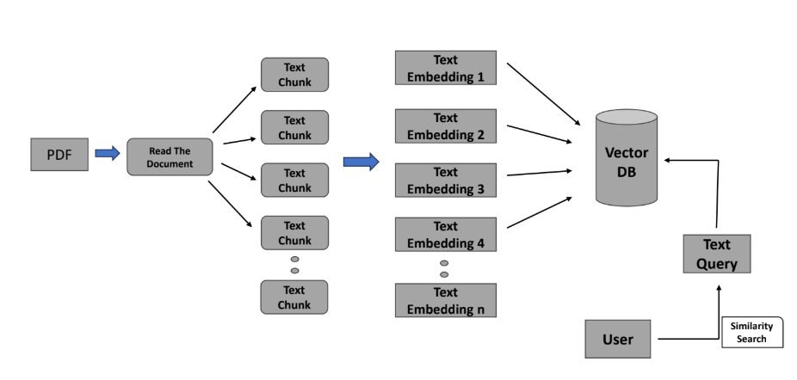
ARCHITECTURE OF RAG

Slide 13

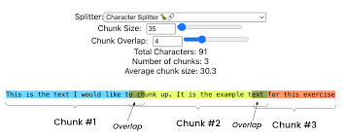
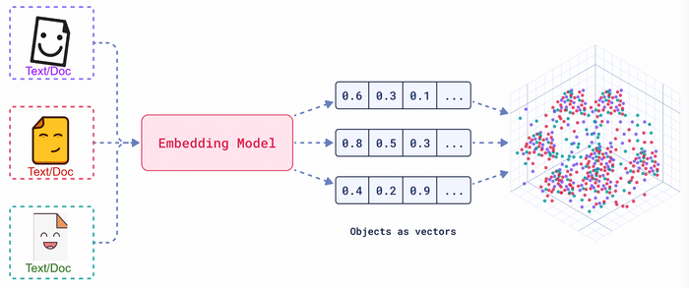
ARCHITECTURE OF RAG
Read The Document:
In storing document architecture and perform similarity search with using llm(Gemini), we
have to first read the document from the user to perform this operation we use pypdf2 library to
load and extract the text from pages from the documents.
Text Chunks:
Text chunks refer to the division of a text into smaller, more manageable pieces of information. These chunks can be sentences, phrases, paragraphs, or even individual words.you can use RecursiveCharacterTextSplitter from langchain text_splitter to create text chunks.
Text Embedding:
embedding the text chunks into numerical representations to store in the
vector database. google genai itself text embedding technique called langchain_google_genai and
model models/embedding-001 to perform this operation.

Slide 14



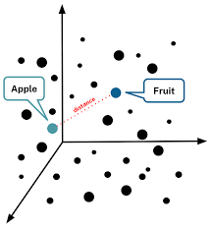
ARCHITECTURE OF RAG
Vector Database:
After embedding the text we store those embedded text into vectorize database in the form
of numerical values. There have several types of vector database there for example chormadb,
faiss-cpu and faiss-gpu.
Text Query:
In text query we takes input from user and using prompt template we will gets the results. load_qa_chain library from langchain.chains.question_answering to answering the question with using prompt template. It used similarity search from vector database to get the result currectly.

Slide 15
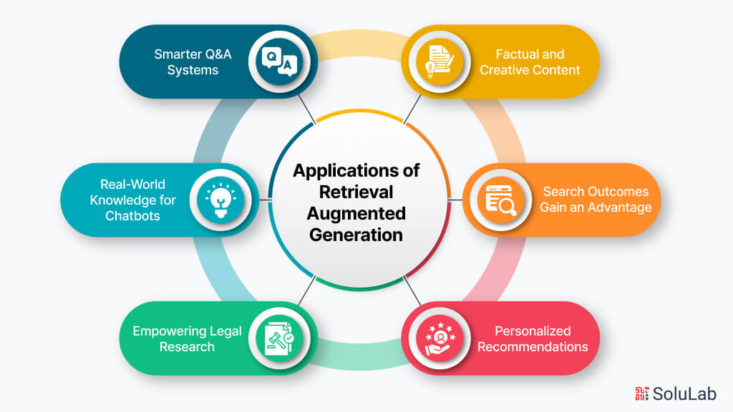
APPLICATION OF RAG

Slide 16
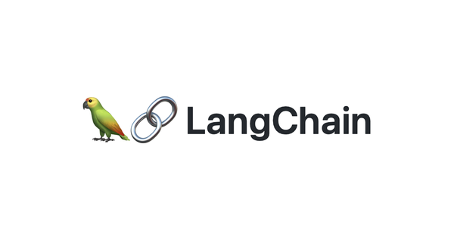




TECHNOLOGY STACK USED FOR BUILD RAG

Slide 17
IMPLIMENT RAG IN CHATBOT
llm model:
gemini api key from that link- https://aistudio.google.com/app/apikey
Technology Stack:
Github(repository):
https://github.com/enderXM249/RAG_System

Slide 18
PROMPT ENGINEERING
Generative artificial intelligence (AI) systems are designed to generate specific outputs based on the quality of provided prompts. Prompt engineering helps generative AI models better comprehend and respond to a wide range of queries, from the simple to the highly technical.
The basic rule is that good prompts equal good results.
Types:
1. Zero-Shot Prompting 🎯
2. One-Shot Prompting 🎯
3. Few-Shot Prompting 🎯
4. Chain-of-Thought (CoT) Prompting 🔗🧠
5. Instruction Prompting 📝
6. Self-Consistency Prompting 🔁
7. Persona-Based Prompting 🎭
8. RAG-Enhanced Prompting 📚 + 🤖

Slide 19
TYPES OF PROMPT
1. Zero-Shot Prompting 🎯
Definition: The model generates a response without any examples or prior training on the specific query.
Use Case: Quick general knowledge queries.
🔹 Example:
"What are the benefits of Retrieval-Augmented Generation (RAG)?"
✅ AI generates an answer based on its pre-trained knowledge.
❌ May lack accuracy if the topic is highly specialized or recent.
2. One-Shot Prompting 🎯
Definition: The model is given one example before generating a response.
Use Case: Helps in structured responses when little context is needed.
🔹 Example:
Example:
Q: What is a Transformer model?
A: A Transformer is an AI model that uses self-attention mechanisms to process sequential data efficiently.
Now, answer this:
Q: What is a GAN?
✅ AI follows the given format to generate an answer.
❌ Limited improvement over zero-shot in complex tasks.

Slide 20
TYPES OF PROMPT
4. Chain-of-Thought (CoT) Prompting 🔗🧠
Definition: Encourages the model to break down complex problems step by step before giving a final answer.
Use Case: Used for reasoning tasks, math problems, and multi-step processes.
🔹 Example:
Q: A factory produces 500 items per day. If each item costs ₹20 to make and they sell at ₹30, what is the daily profit?
Think step by step:
1. Find the cost of producing 500 items.
2. Find the revenue from selling 500 items.
3. Calculate profit by subtracting the cost from the revenue.
✅ AI generates an answer logically instead of guessing.
✅ Reduces hallucinations in complex AI reasoning tasks.

Slide 21
TYPES OF PROMPT
5. Instruction Prompting 📝
Definition: Clearly instructing the AI to follow a set of rules or format in its response.
Use Case: Used in structured applications like RAG-powered AI assistants.
🔹 Example:
"You are a financial analyst. Retrieve the latest stock market trends and generate:
- A summary in 100 words.
- Three key insights.
- Recommendations for investors."
✅ AI follows explicit rules and structured output.
✅ Useful for financial reports, legal summaries, research papers.
7. Persona-Based Prompting 🎭
Definition: AI is instructed to adopt a specific persona or role when responding.
Use Case: Used in chatbots, AI tutors, and industry-specific applications.
🔹 Example:
"You are a senior doctor explaining the symptoms of diabetes to a 10-year-old child. Use simple and engaging language."
✅ AI adjusts tone, complexity, and audience-specific explanations.
✅ Used for customer service, education, and interactive AI.

Slide 22


PROMPT ENGINEERING USE CASES:
As generative AI becomes more accessible, organizations are discovering new and innovative ways to use prompt engineering to solve real-world problems.
Chatbots
Prompt engineering is a powerful tool to help AI chatbots generate contextually relevant and coherent responses in real-time conversations. Chatbot developers can ensure the AI understands user queries and provides meaningful answers by crafting effective prompts.
Healthcare
In healthcare, prompt engineers instruct AI systems to summarize medical data and develop treatment recommendations. Effective prompts help AI models process patient data and provide accurate insights and recommendations.

Slide 23
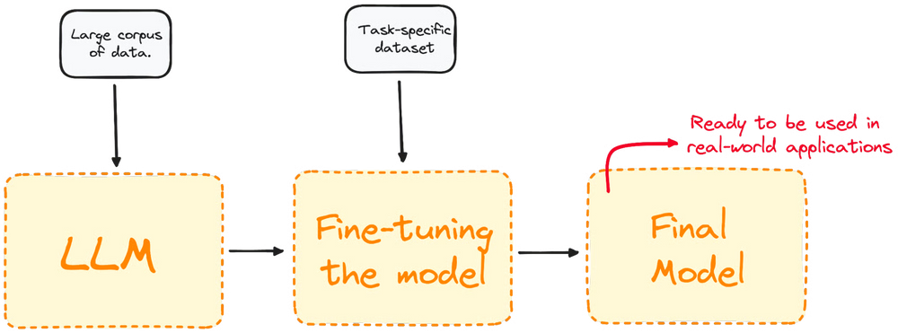
FINE TUNNING
Fine-tuning is the process of adjusting a pre-trained model to better fit a specific task or dataset. The goal is to improve the model's performance and accuracy.
Most LLM models today have a very good global performance but fail in specific task-oriented problems. The fine-tuning process offers considerable advantages, including lowered computation expenses and the ability to leverage cutting-edge models without the necessity of building one from the ground up.

Slide 24
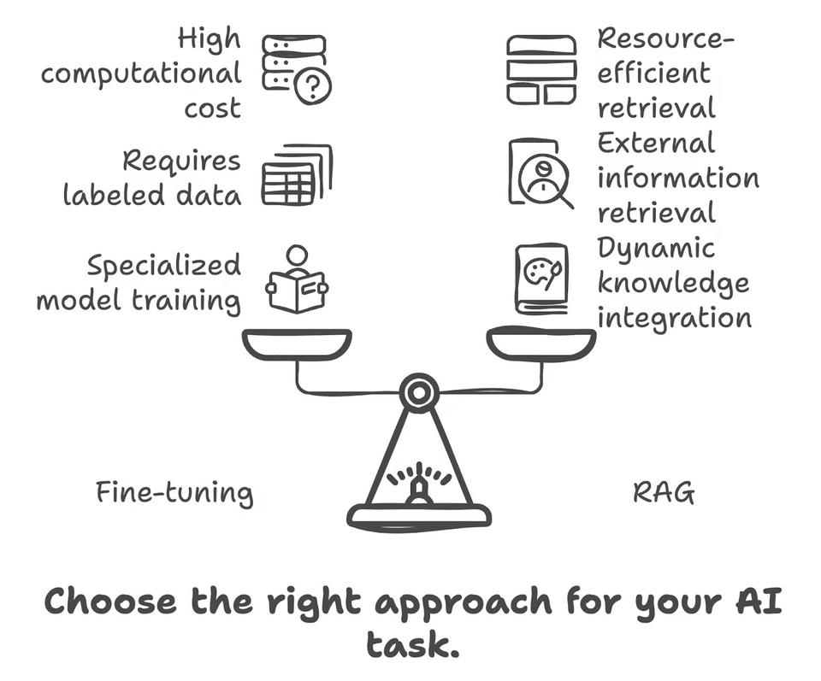
FINE-TUNING VS. RAG
The difference between RAG and fine-tuning is that RAG augments a natural language processing (NLP) model by connecting it to an organization’s proprietary database, while fine-tuning optimizes deep learning models for domain-specific tasks. RAG and fine-tuning have the same intended outcome: enhancing a model’s performance to maximize value for the enterprise that uses it.
RAG uses an organization’s internal data to augment prompt engineering, while fine-tuning retrains a model on a focused set of external data to improve performance.

Slide 25
SOME POPULAR PROJECT
Character.ai
ICD10 code generator
human disease classification
plant disease classification
gitaGpt
Automated personalized chatbot for applying job

Slide 26
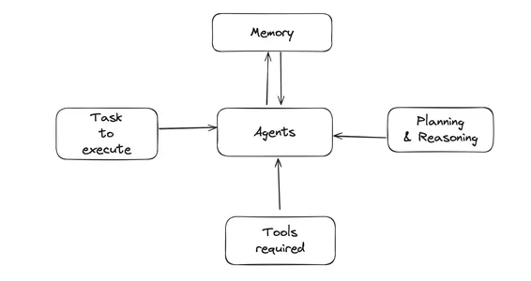
AGENTIC AI
Agentic is a new way of using AI, specifically large language models (LLMs) like me, to tackle complex tasks. It’s different from the traditional approach where you just give an LLM a prompt and get a response. But in Agentic AI there have multiple agents/llm to perform perticular task and collaburatly perform a certain task
Multiple AI agents: Instead of a single LLM, agentic workflows use several AI agents, each with specific roles and functions. Think of them as a team working together.
Iterative process: The task is broken down into smaller, more manageable steps. The AI agents tackle each step, and you can provide feedback along the way. This lets the agents learn and improve as they go.
Collaboration: The agents can work together, sharing information and completing subtasks to achieve the final goal.
Understanding Autonom

Slide 27


TECHNOLOGY USED TO IMPLIMENT IT
https://docs.crewai.com/quickstart
https://docs.phidata.com/introduction

